Slide 1

Subwords to encoder
Notes:
‹#›

Slide 2
Objectives
Review the Subwords to encoder
Implement the classifier for IMDB dataset using subwordTextEncoder
Subwords to encoder
‹#›

Slide 3
Review the Subwords to encoder
The lib: tfds.deprecated.text.SubwordTextEncoder
What is it ?
Why using it ?
→ student discuss and give the answer.
Hind: https://www.tensorflow.org/datasets/api_docs/python/tfds/deprecated/text/SubwordTextEncoder
Subwords to encoder
‹#›
Notes:
‹#›

Slide 4
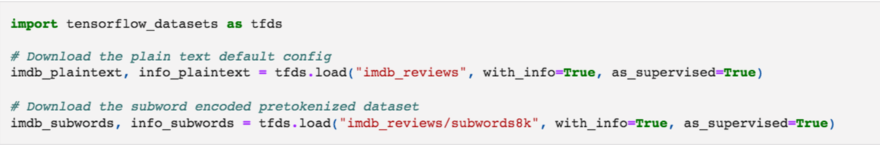

Subword Tokenization
Download the IMDB reviews plain text and tokenized datasets
plain_text - this is the default and the one you used in Lab 1 of this week
subwords8k - a pre-tokenized dataset
Subwords to encoder
‹#›
Notes:
‹#›

Slide 5
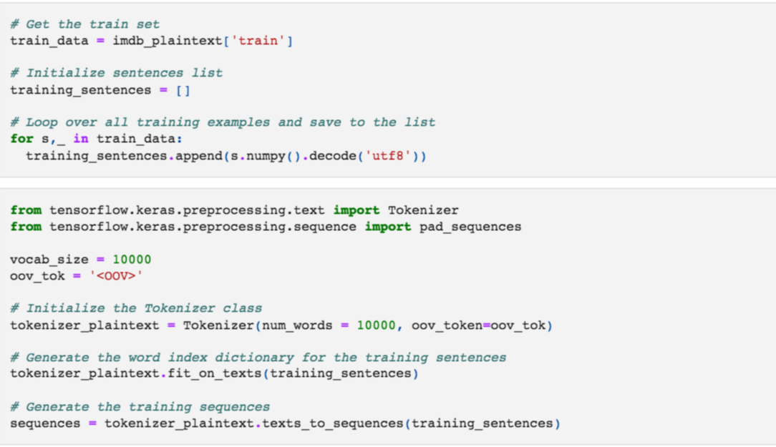
Subword Tokenization
Subword Text Encoding
Subwords to encoder
‹#›
Notes:
‹#›

Slide 6

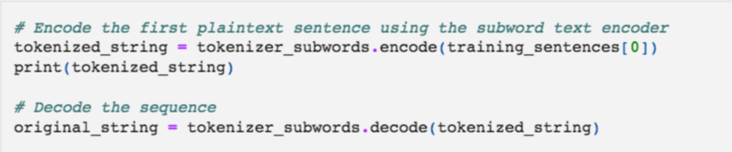
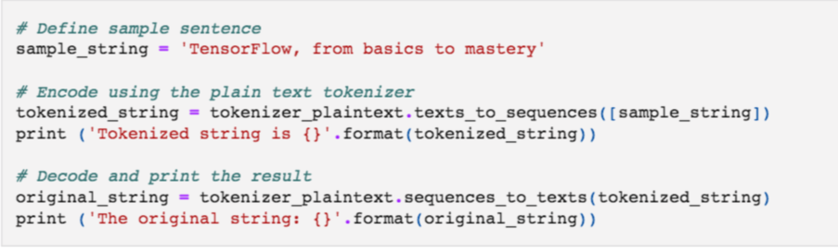
Subword Tokenization
Subword Text Encoding
Subwords to encoder
‹#›
Notes:
‹#›

Slide 7
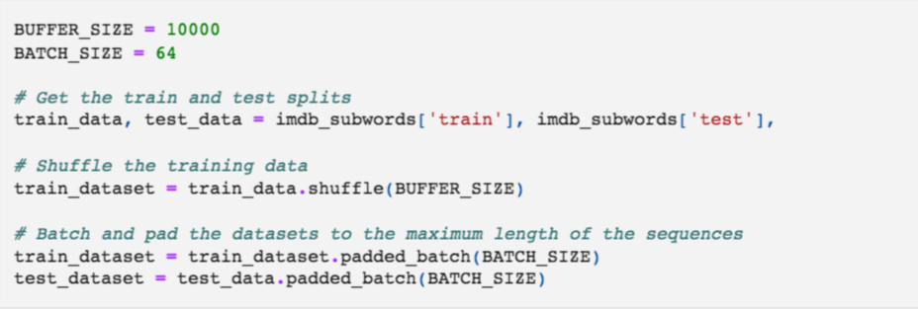
Subword Tokenization
Prepare for training
Subwords to encoder
‹#›
Notes:
‹#›

Slide 8
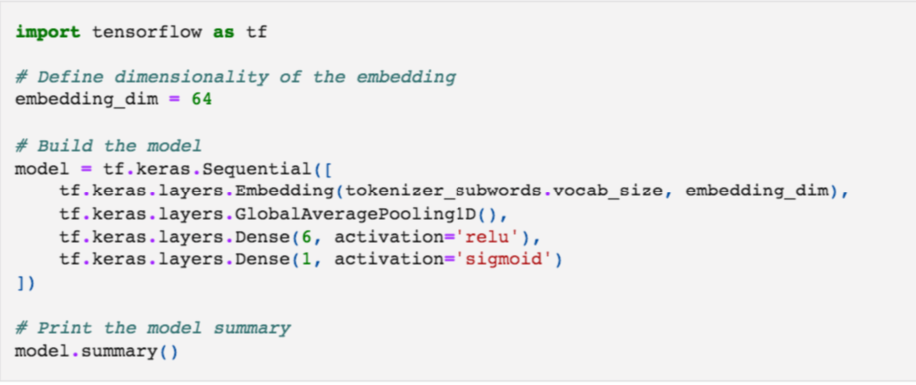
Subword Tokenization
Build model
Subwords to encoder
‹#›
Notes:
‹#›

Slide 9
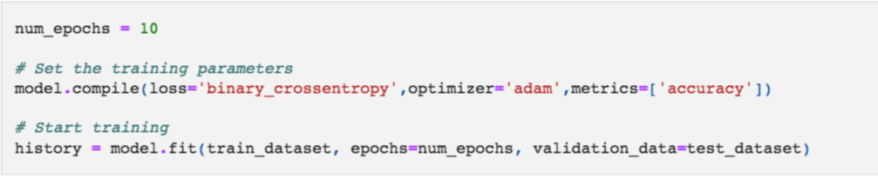
Subword Tokenization
Training model
Subwords to encoder
‹#›
Notes:
‹#›

Slide 10
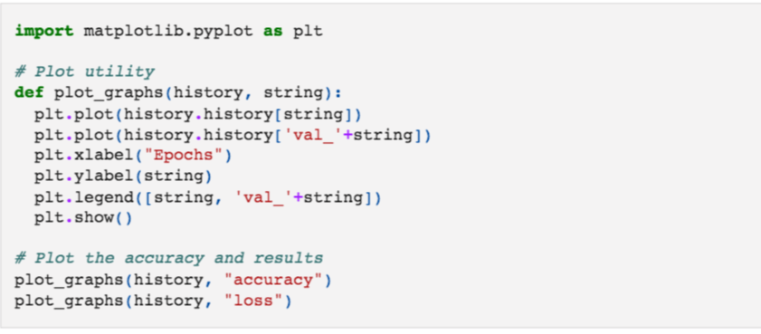
Visualize the results
Subwords to encoder
‹#›
Notes:
‹#›

Slide 11
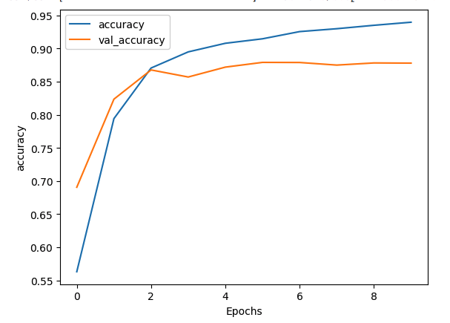
Visualize the results
Subwords to encoder
‹#›
Notes:
‹#›

Slide 12
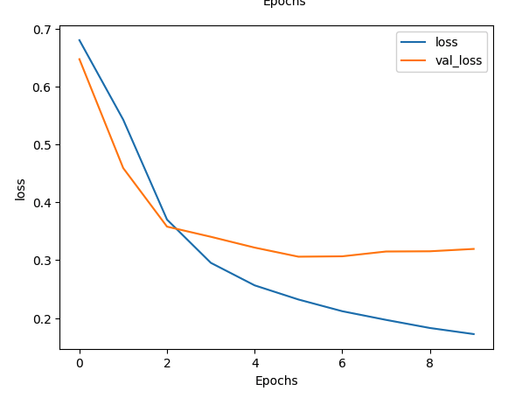
Visualize the results
Subwords to encoder
‹#›
Notes:
‹#›

Slide 13
Summary
Review the Subwords to encoder
Implement the classifier for IMDB dataset using subwordTextEncoder
Subwords to encoder
‹#›

Slide 14
Q & A
Subwords to encoder
‹#›

